Slide 1
Chapter Three
The Causes of Diving Accidents

Slide 2
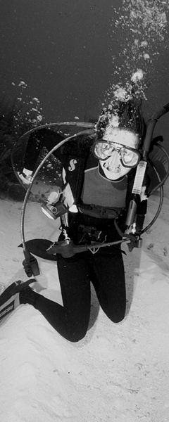
Topics In This Chapter
How Diving Accidents Happen
Exceeding Prior Experience and Training
Cold or Tired Diver
Muscle Cramps
Over-Weighted Diver
Ocean Currents
Rivers and Streams
Gear Problems
Injuries
Hyperthermia
Hypothermia

Slide 3
How Diving Accidents Happen
Although an occasional accident is inevitable
Compared to some other sports, diving is relatively safe
Safety stems from well-defined standards and instructional procedures
Participants are trained to operate safely in an unforgiving environment
Accidents frequently involve some type of diver error or inattention, and most are preventable

Slide 4
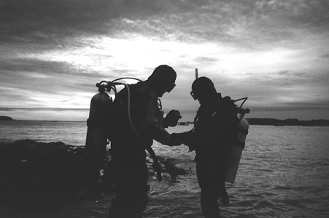
Exceeding Prior Experience and Training
Novice divers may encounter difficulty in
dives that surpass their abilities
First deep water dive
First boat dive
First night dive

Slide 5
Exceeding Prior Experience and Training
Certain types of dives require specialized
training
Dives deeper than 30 m / 100 ft
Penetration wreck diving
Cave diving
Ice diving

Slide 6
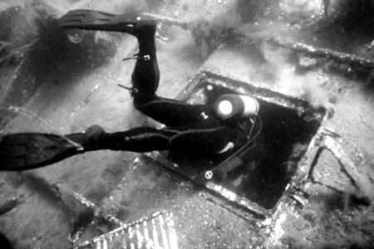
Exceeding Prior Experience and Training
Possible hazards of overhead environments
No direct access to the surface
Disorientation
Silt-out
Falling objects
Entanglement

Slide 7
Cold or Tired Diver
A person loses heat faster in water than in
air at the same temperature
Exposure protection typically is required
Wet suits are selected by thickness, for warm to cold water
Dry suits often are used for temperatures below 13^{O}C / 55^{O}F
Cold divers will experience a loss of energy and stamina

Slide 8
Cold or Tired Diver
Diving requires an output of energy – Appropriate physical fitness is required !
Leg muscles used to propel diver through a dense medium
Carrying and wearing heavy equipment
Swimming against currents
Entries through surf or over rocks
Climbing vertical boat ladders
Hauling a camera or loaded game bag

Slide 9
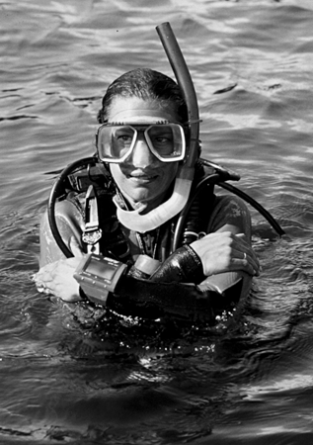
Cold or Tired Diver
Recognizing a cold or tired diver
Moving slowly, without a consistent course
Wandering on surface, too tired to look where he’s going
Uncoordinated movements, lacking fine motor skills
Frequent stops or rest breaks
Motionless on surface or underwater for long periods

Slide 10
Muscle Cramps
What is a cramp?
Forceful, continuous, and involuntary muscle contraction
Most often occurs in the lower leg (calf) or in the foot
Also may occur in the upper leg (hamstring)

Slide 11
Muscle Cramps
Cramps may be prompted by . . .
Sustained effort
Poorly fitted fins or fin straps
Cold water
Dehydration
Inadequate nutrition
Lack of physical conditioning

Slide 12
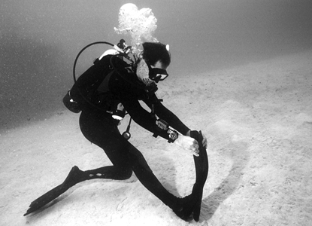
Muscle Cramps
Dealing with cramps
Grab your fin tip and pull upwards
Also may assist buddy, by pushing upwards on bottom of his fin tip

Slide 13
Muscle Cramps
Prevention is the best cure
Regular exercise
Plenty of clear fluids during dive days
Boots and fins that fit properly
Adequate exposure protection
Foods high in potassium

Slide 14
Over-Weighted Diver
Proper weighting
Should float at eye level with an empty BC, while holding a normal breath

Slide 15
Over-Weighted Diver
Excessive weight requires additional
inflation of BC
For positive buoyancy at the surface
For neutral buoyancy underwater

Slide 16
Over-Weighted Diver
Additional inflation of BC
Causes unnecessary drag and exertion while swimming
May constrict torso and affect breathing
May limit ability to reach and handle other gear

Slide 17
Ocean Currents
Currents can be overpowering and
exhausting
Survey the dive site for surface currents, tides, rips, and longshore currents
Plan your dive accordingly
Start your dive against the current
Use the current to help get back to your exit point
Use appropriate lines when boat diving

Slide 18
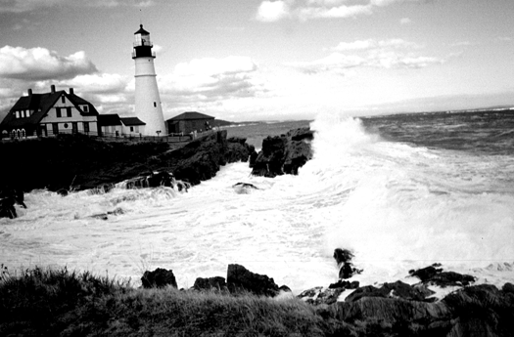
Ocean Currents
If caught in a current at the surface
Establish positive buoyancy
Swim perpendicular to the current

Slide 19
Freshwater Rivers and Streams
Diving in fast moving water is hazardous
Flowing water is powerful and can sweep away a diver
Underwater entanglements pose a greater risk in moving water
Be wary of eddies and other hydraulics
Anything that interrupts the main direction of flow will result in current reversals that can trap a diver underwater
Learn to read the river

Slide 20
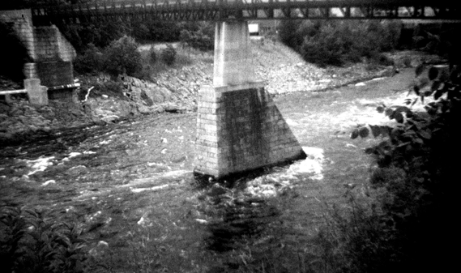
Freshwater Rivers and Streams
If pinned underwater by a reversal
Swim on the bottom, as deep as possible, to emerge downstream
Surfacing too soon may result in being carried back upstream by the reversing current, and then pulled underwater again

Slide 21
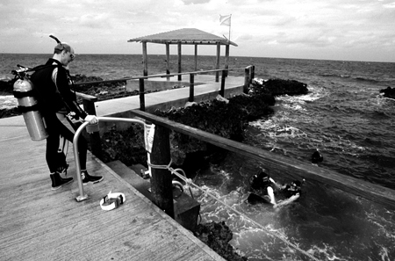
Gear Problems
Properly maintained equipment rarely fails
during a dive
Annual servicing for regulators and BC’s

Slide 22
Gear Problems
Regulator malfunctions
Free-flow, caused by elevated intermediate pressure
Free-flow, caused by ice in the first or second stage valve
Stoppage, caused by ice blocking the flow of gas
Ice may form inside a regulator in water temperatures below 10^{O}C / 50^{O}F

Slide 23
Gear Problems
Hose failure
High pressure hose: louder noise
Low pressure hose: more rapid loss of gas

Slide 24
Gear Problems
BC malfunctions
Inflator mechanism: over-inflating or not inflating
Air loss from BC bladder or dump valve

Slide 25
Gear Problems
Other gear problems
Broken mask strap
Broken fin strap

Slide 26
Injuries
Dive site injuries
May have little to do with actual diving
Most often they will be minor in nature

Slide 27
Injuries
Hazard of passing boats
Appropriate use of dive flags
Special permission from authorities for diving in designated ship channels
Observe areas that are “off limits” to divers

Slide 28
Injuries
Other hazards
Rocky shorelines
Slippery boat decks
Carrying heavy gear

Slide 29
Injuries
Be prepared to deal with injuries
Obtain first aid and oxygen training
Have a first aid kit and oxygen available

Slide 30
Hyperthermia
Elevated body core temperature
Exposure protection may contribute, while out of water
Body’s coping mechanism is perspiration
Heat exhaustion: weakness, nausea, loss of alertness
Heat stroke: life-threatening, body is no longer able to regulate core temperature

Slide 31
Hyperthermia
Considerations
Buddy team should coordinate their gearing-up process
Avoid donning exposure suit too early
Don’t hesitate to cool off

Slide 32
Hypothermia
Drop in body core temperature
Diminished sense of awareness and survival skills
Impacts ability to think rationally and function normally
Decreased motor coordination

Slide 33
Hypothermia
Shivering
Effective method of producing heat
Indicates that the body is fighting heat loss

Slide 34
Hypothermia
In addition . . .
The brain constricts the blood vessels under the skin, and directs the blood primarily towards the lungs and major organs

Slide 35
Hypothermia
Buddy considerations
Ensure that all divers are comfortable during the dive
Terminate the dive, whenever a diver becomes cold

Slide 36
Summary
Almost all dive accidents are preventable
Stay within the limits of your training and experience
Keep in good physical condition
Maintain equipment in good working order
Practice proper buoyancy control
Get sufficient rest before diving
Pay attention to conditions and stay alert

Slide 37
Scuba I.Q. Review

Slide 38
Scuba IQ Review
1
Q
List four common problems that may lead to diving accidents.
A
Exceeding prior experience and training
Cold or tired diver
Muscle cramps
Overweighting
Currents
Equipment

Slide 39
Scuba IQ Review
2
Q
Relative to the observer on the shore, in which direction do the tides run?
A
Parallel to the shoreline

Slide 40
Scuba IQ Review
3
Q
What is one way of solving the problem of divers being unable to swim back to the dive boat against the current?
A
Trail a long, floating drift line aft of the boat.
Run a water level line from the entry point to the descent line.

Slide 41
Scuba IQ Review
4
Q
What are rip currents?
and How are they formed?
A
Rips are relatively high-speed currents that move out to sea from the shore. They may be produced by high tide waters accumulating behind barrier reefs and then flowing to the sea with great force as the tide changes. Rips may also be produced by currents that move parallel to the shoreline.

Slide 42
Scuba IQ Review
5
Q
Describe the danger of strainers to river divers.
A
The diver can become entangled or caught in debris and unable to free themselves due to the current holding the diver in place.

Slide 43
Scuba IQ Review
6
Q
Why are low-head dams and other hydraulics so dangerous to divers?
A
A diver may be carried to and pinned on the bottom by the relentless current.

Slide 44
Scuba IQ Review
7
Q
The water need not be freezing cold for a free-flow or freeze up to occur. Why is this so?
A
A deep dive with its associated high air demands and thus cooling effect of air passing through valve stems, may be sufficient to cause ice to form.

Slide 45
Scuba IQ Review
8
Q
What kinds of injuries might you expect to find on a diver struck by a boat?
A
Head injuries are a typical result though broken arms, collarbones and neck injuries are frequent as well.

Slide 46
Scuba IQ Review
9
Q
List the four ways in which our bodies lose heat to the environment.
A
Perspiring and losing heat through evaporation
Warming the air in contact with the skin (Conduction)
Removing warm air from around skin (Convection)
Emitting infrared radiation

Slide 47
Scuba IQ Review
10
Q
Describe the two main methods the body uses to manage heat loss in cold water.
A
Shivering
The brain constricts the blood vessels under
the skin, and directs the blood primarily
towards the lungs and major organs

Slide 48
Scuba IQ Review
11
Q
Discuss the dangers of diving in overhead environments without specialized training.
A
No direct access to the surface
Disorientation
Silt-out
Falling objects
Entanglement hazards

Slide 49
Any Questions ?

